Slide 1

midterm presentation – Team Airline

Slide 2
Our Project
pricing simulation: mimics a market for selling airplane tickets
goal: compare different methods in realistic scenarios
implemented several DP methods to calculate optimal solution
suitable for all stable baselines algorithms
comprehensive monitoring to analyze pricing strategies and compare RL-based policies with the optimal one

Slide 3
The pricing problem
monopoly scenario: agent vs customers
dynamic pricing
problem context:
time horizon: finite (→ take off)
action: price offer
demand: price and time-dependent
rewards: sales revenue
goal: maximize profits

Slide 4
The pricing problem
monopoly scenario: agent vs customers
dynamic pricing
problem context:
time horizon: finite (→ take off)
action: price offer
demand: price and time-dependent
rewards: sales revenue
goal: maximize profits
environment:
state space: (booking time, current occupancy) (0, 0) → (49, 99)
action space: discrete (0, 10, 20, …, 100)
event: tickets sold per step (0, 20)
reward: price x #tickets sold
(no final reward)
demand: (1 − a / 4 0 0 ) ⋅ (1 + t ) / T
episode: one booking period

Slide 5
The pricing problem
monopoly scenario: agent vs customers
dynamic pricing
problem context:
time horizon: finite (→ take off)
action: price offer
demand: price and time-dependent
rewards: sales revenue
goal: maximize profits
environment:
state space: (booking time, current occupancy) (0, 0) → (49, 99)
action space: discrete (0, 10, 20, …, 100)
event: tickets sold per step (0, 20)
reward: price x #tickets sold
(no final reward)
demand: (1 − a / 4 0 0 ) ⋅ (1 + t ) / T
episode: one booking period
What would a good policy look like?

Slide 6
A simulation scenario
optimal solution (full knowledge)
→ calculated by backward induction
RL solution (limited knowledge)
Q-Learning: (g=, eps=, ..)
PPO: (from stable baselines library)
SAC: (…)
A2C: (…)
training: 100 episodes (50k steps)
→ XX sec.
evaluation: final policy after training in one episode

Slide 7
A simulation scenario
optimal solution (full knowledge)
→ calculated by backward induction
RL solution (limited knowledge)
Q-Learning: (g=, eps=, ..)
PPO: (from stable baselines library)
SAC: (…)
A2C: (…)
training: 100 episodes (50k steps)
→ XX sec.
evaluation: final policy after training in one episode
environment:
state space: (booking time, current occupancy) (0, 0) → (49, 99)
action space: discrete (0, 10, 20, …, 100)
event: tickets sold per step (0, 20)
reward: price x #tickets sold
(no final reward)
demand: (1 − a / 4 0 0 ) ⋅ (1 + t ) / T
episode: one booking period

Slide 8
A simulation scenario – optimal policy
Diagramm:
price
state
action

Slide 9
A simulation scenario – selected RL policies
deviation heat maps…
Q-Learning
SAC
PPO

Slide 10
A simulation scenario – total rewards
total rewards all OR value iteration evaluation??

Slide 11
Outlook
more complex customer behavior (various customer types)
multidimensional state space to support multiple flights (demand substitution effects)
agent predicts customer behavior
introduce competition to agent
What do you think is the most interesting direction?

Slide 12


Slide 13


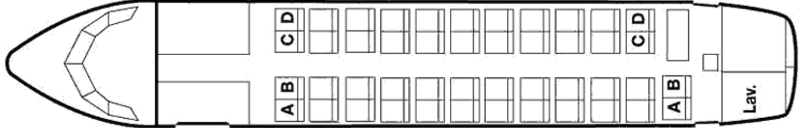


The pricing problem

